Slide 1


WELCOME

Slide 2
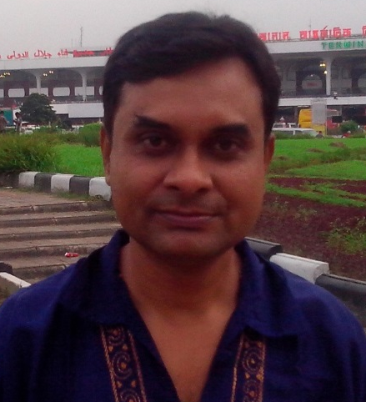

Presented by-
M.A.Wadud
Senior Teacher(English)
Binnati A.M.M. High School
Kishoreganj Sadar.
ID No-2O
Class-9
Subject-English
Paper-1
Unit-3,Lesson-2
Time-5o minites

Slide 3
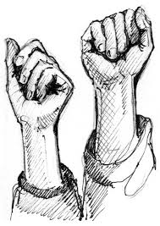
Sec:-A. Look at the picture and talk about it.

Slide 4
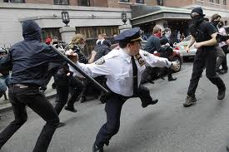
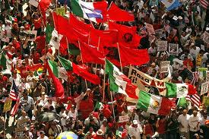

Slide 5
(1) What do you see in the picture?
( 2).Can you relate any historical event of this picture?
(3).What happend on this day?

Slide 6
M
A
Y
D
A
Y

Slide 7
By the end of the lesson the ss will be able to-
talk about events and festivals
ask and answer questions and give opinion in a logical sequence
Infer meaning from the text
Write a paragraph about May Day

Slide 8
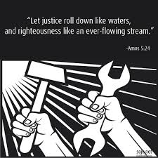
VOCABULARY
Struggle
The working people struggle to establish an eight- hour work day.
To try very hard to do sth when it is difficult or when there are a lot of problem.

Slide 9
Our text is here
Unit-3, Lesson-2
Look at the following picture and talk about it.

Slide 10
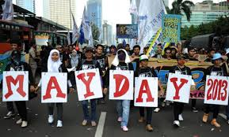

Slide 11



Slide 12
Sec:-C, (Pair Work)
Fill in the blanks with the verbs given in the box.Put them into their correct forms.

Slide 13
Sec:- D,( Individual work):-
Now read the complete passage in c silently and answer the following questions:-
1).Do you think Tania’s monthly salary is en1ough for her work?
2).Does Tania lives in a hygienic place?
3).Is it good for her health?
4).Do you have any suggestions for factory workers’ general health, happiness and safety? If so, what?

Slide 14
Evaluation:- 1).What does May Day refer to?
2).How long did the workers have to work a day before the May 1 strike?
3).How many workers’ were victimised for taking part in the strike?

Slide 15
Home Work:-
Do you find any similarity or dissimilarity with May Day and International Mother Language Day? If you find, write it.

Slide 16

Thanks to all

